Slide 1
Centaurus Edge Design Review

Slide 2
Agenda
Use Cases & Requirements
Edge Modeling & Design
Progress (POC, timelines)

Slide 3
Agenda
Use Cases & Requirements
Edge Modeling & Design
Progress (POC, Timelines)

Slide 4

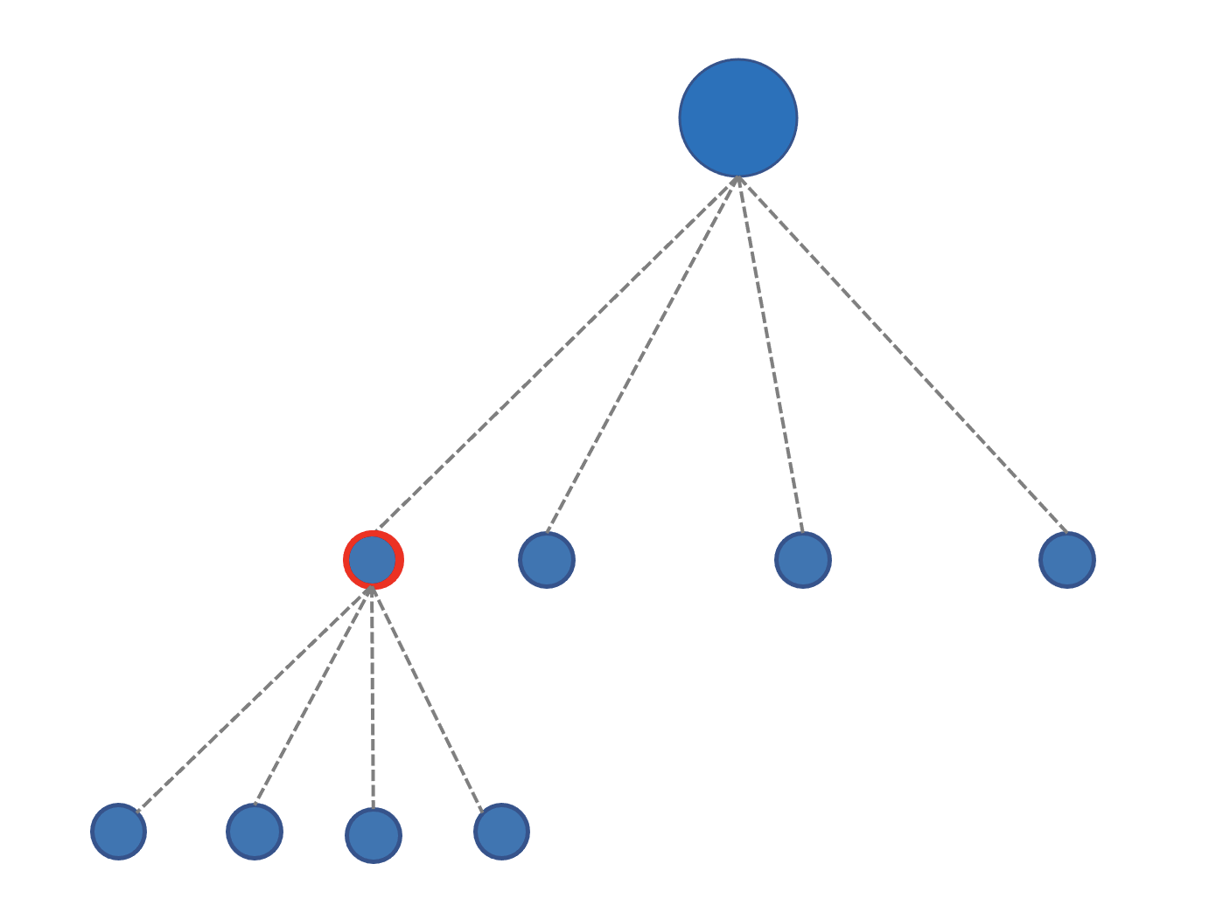
Use Case Focus
Applications
IoT
“Industry 4.0”, smart factories
5G & MEC
Key requirements
Locality
Workload
Control flow
Autonomy
High availability
Flexibility

Slide 5
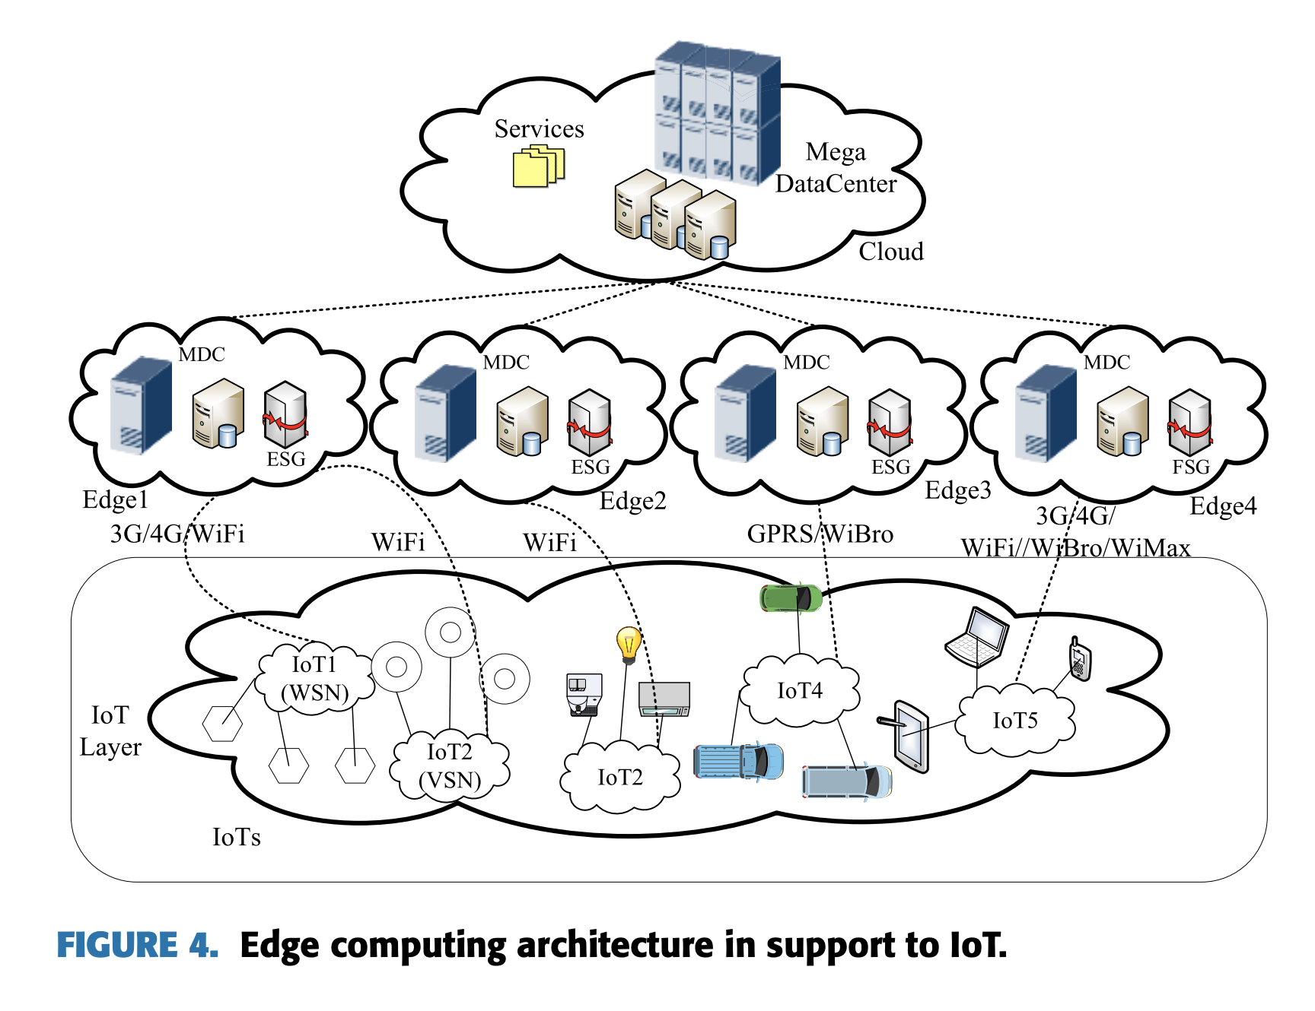
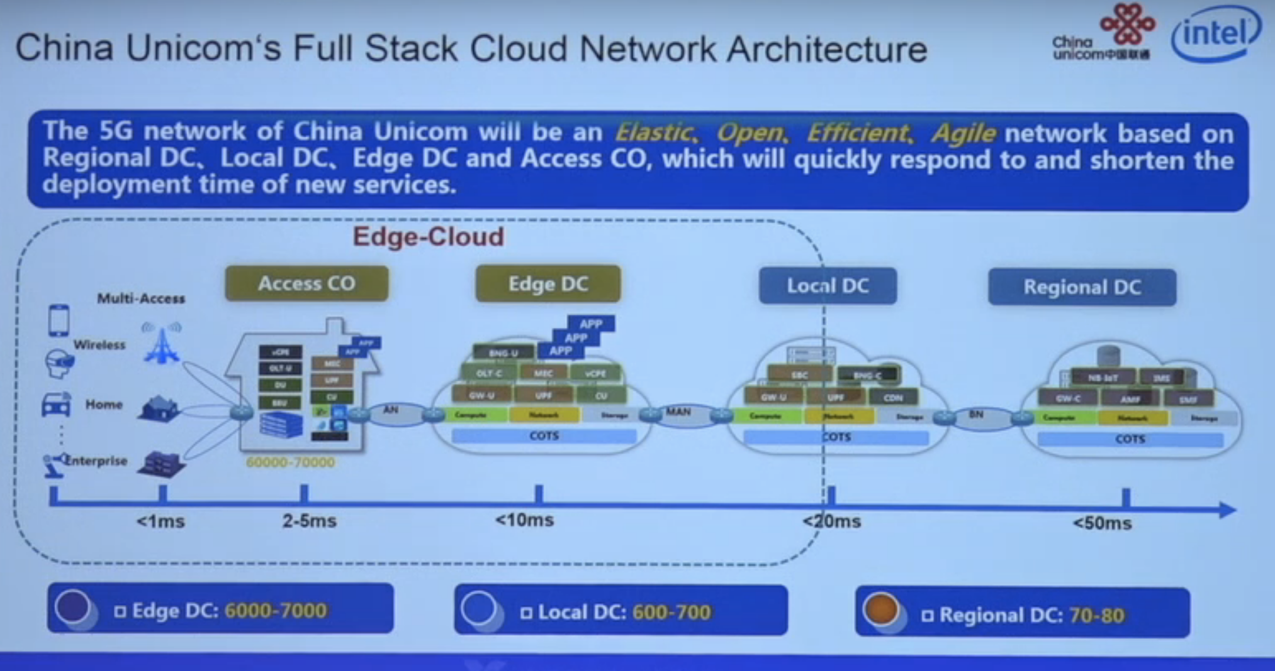
Use Cases Examples
https://youtu.be/1BM803fy5io
https://ieeexplore.ieee.org/iel7/6287639/8600701/08758431.pdf

Slide 6
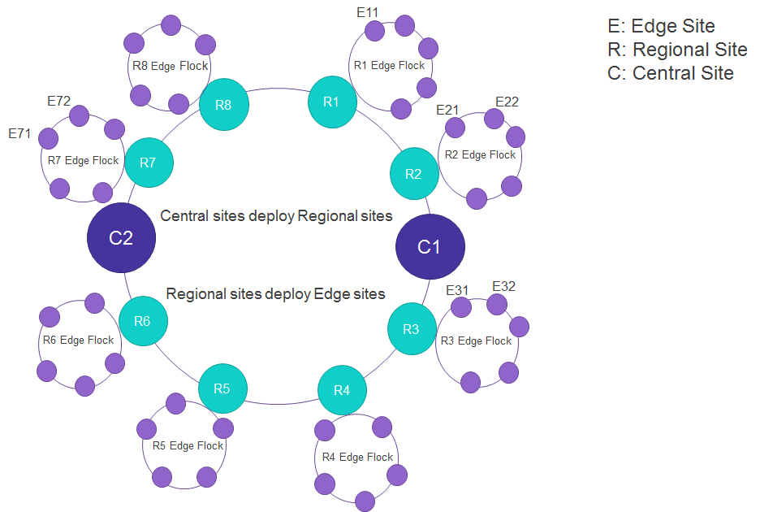
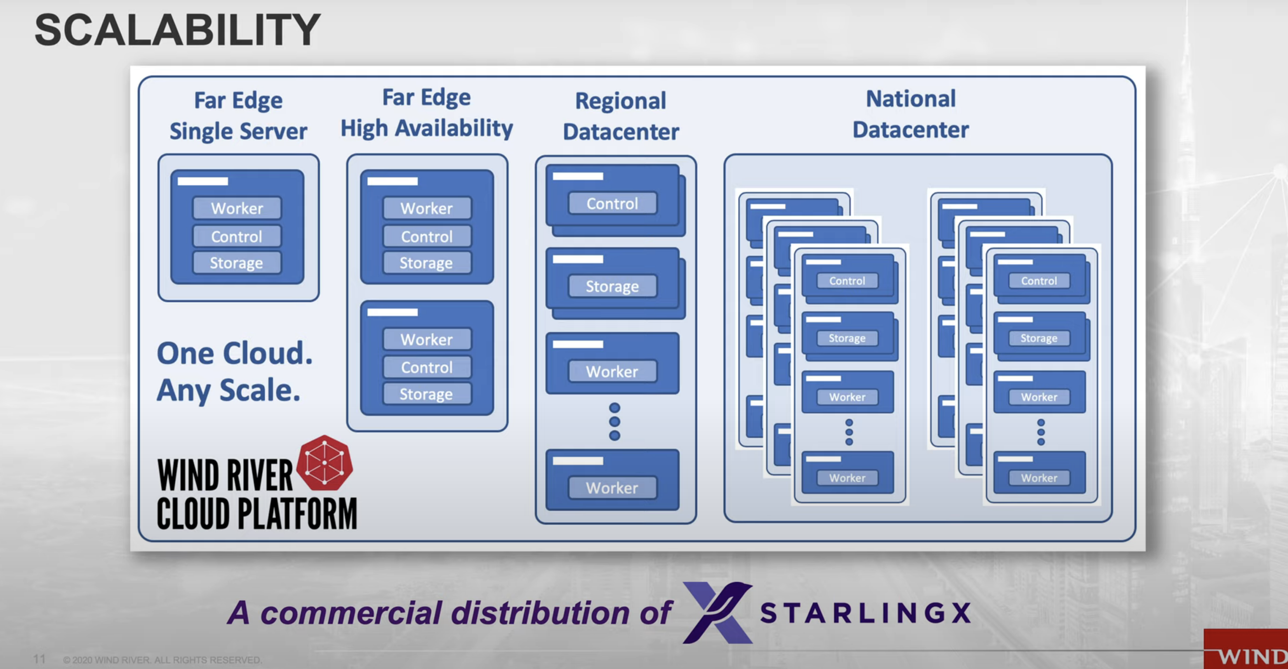
Use Cases Examples
https://youtu.be/8I8TuQ1evKk
https://youtu.be/i9TPWE98KL8
https://wiki.akraino.org/display/AK/Akraino+Edge+Stack

Slide 7
Agenda
Use Cases & Requirements
Edge Modeling & Design
Progress (POC, Timelines)

Slide 8
Edge Modeling
Cloud
Internet
Edge Data Center (Region x, AZ i)
Edge Data Center (Region y, AZ j)
Edge Data Center (Region z, AZ k)
Devices
Devices
Internet
Devices

Slide 9
Edge Modeling
Cloud
Internet
Edge Site
Edge Site
Edge Site
Edge Site
Edge Site
Devices
Internet
Edge Site
Devices
Devices
Devices

Slide 10
Edge Is Hierarchical
Separate control from action, in each geographic region
Local > Global
Latency matters
Data locality & privacy
Global > Local
Regional analytics & policy
Autonomy
Regional control & management

Slide 11

Key Edge Requirements
Edge workloads continue functioning when
Edge-cloud network disconnect
Edge node down
Both 1 and 2 happen at the same time
Functioning
Workload continues running
Control access remains open

Slide 12
Key Edge Requirements, cont
Centralized Management
Regional Offline Access
Load balancing
Service Discovery
Multi-dimensional auto-scaling
Workload Deployment
Log Collection
Monitoring

Slide 13
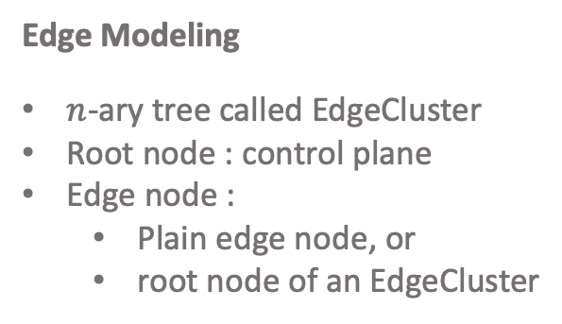
Cloud Control Plane
Edge Modeling
$n$-ary tree called EdgeCluster
Root node : control plane
Edge node :
Plain edge node, or
root node of an EdgeCluster
Cloud Node Pool
Multiple-role node
Cloud node
Edge node
EdgeCluster master
Control plane
Comm with upstream

Slide 14
Edge Cluster Provisioning
Option 1: Self-organizing

Slide 15
Edge Cluster Provisioning
Option 2: Attachment

Slide 16
Agenda
Use Cases & Requirements
Edge Modeling & Design
Progress (POC, Timelines)

Slide 17

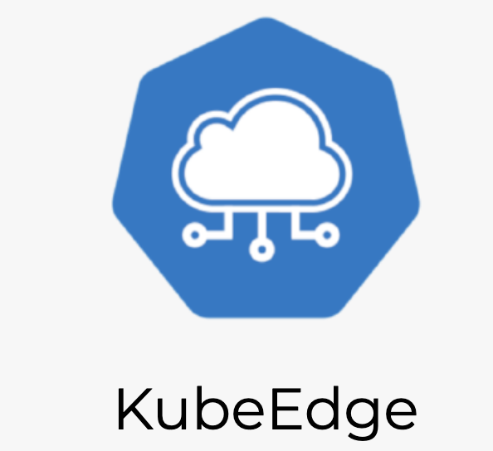


Progress
POC → Design → Implementation
POC goals
Cluster Management
Monitoring
Workload
Creation
Deletion
Offline running
Network
Node

Slide 18
3/24 (today)
3/31
POC feature tracking
Feature Scoping
Review
4/13
4/20
4/27
3/24 (today)
Community
Review
Discussion with Liguang
TSC
4/28
POC
Review
4/1
5/5
5/23
Design doc draft for 4/30
Feature Design
Review
KubeCon Abstract
[6,7,8]/30
5/6
Release Planning

Slide 19
Backup Slides

Slide 20

Mode 1:
Mode 2:
/c1/c11
/c1/c12
/c2
/c1/c11
/c1/c12
/c2
control
/c11
/c12
……
c1
/c21
/c22
……
c1
c2
Control?
c2
c11
c12
c11
c12
Pros:
Edge clusters don’t want/need to (or can’t) expose endpoints
Cons:
Potentially longer control plane latency
Cannot tolerate control connection (red) disconnect
EdgeCluster always requires network access to cloud
Higher load onto cloud control plane
Pros:
Flexible control endpoints → lower control latency (as close to cluster as possible)
Better toleration to control connection disconnect
EdgeCluster doesn’t always requires network access to cloud
Lower load onto cloud control plane
Cons:
Complex cloud control plane
Requires EdgeCluster to expose endpoints (fall back to mode 1 if not possible at all)
Best for: “Clusters on internet”
Best for: “Clusters on-prem within firewall”

Slide 21
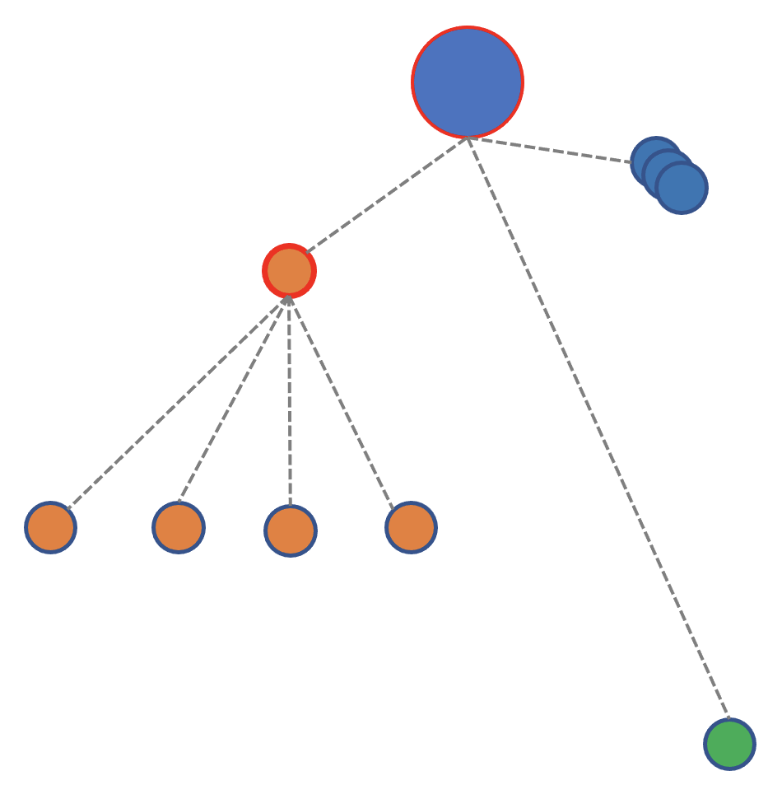
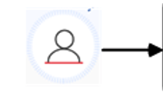
EdgeCluster
Cloud Core
Controllers
Edge Controller
K8S
API Server
Device Controller
Cloud Hub
Edge Core
Edge Hub
SQLite
MetaManager
Device Twin
watch
ServiceBus
ETCD
EdgeClusterd
Edged
EventBus
EdgeCluster Control Plane
EdgeClusterd
Sync workload & controls from cloud
Sync cluster status to the cloud

Slide 22
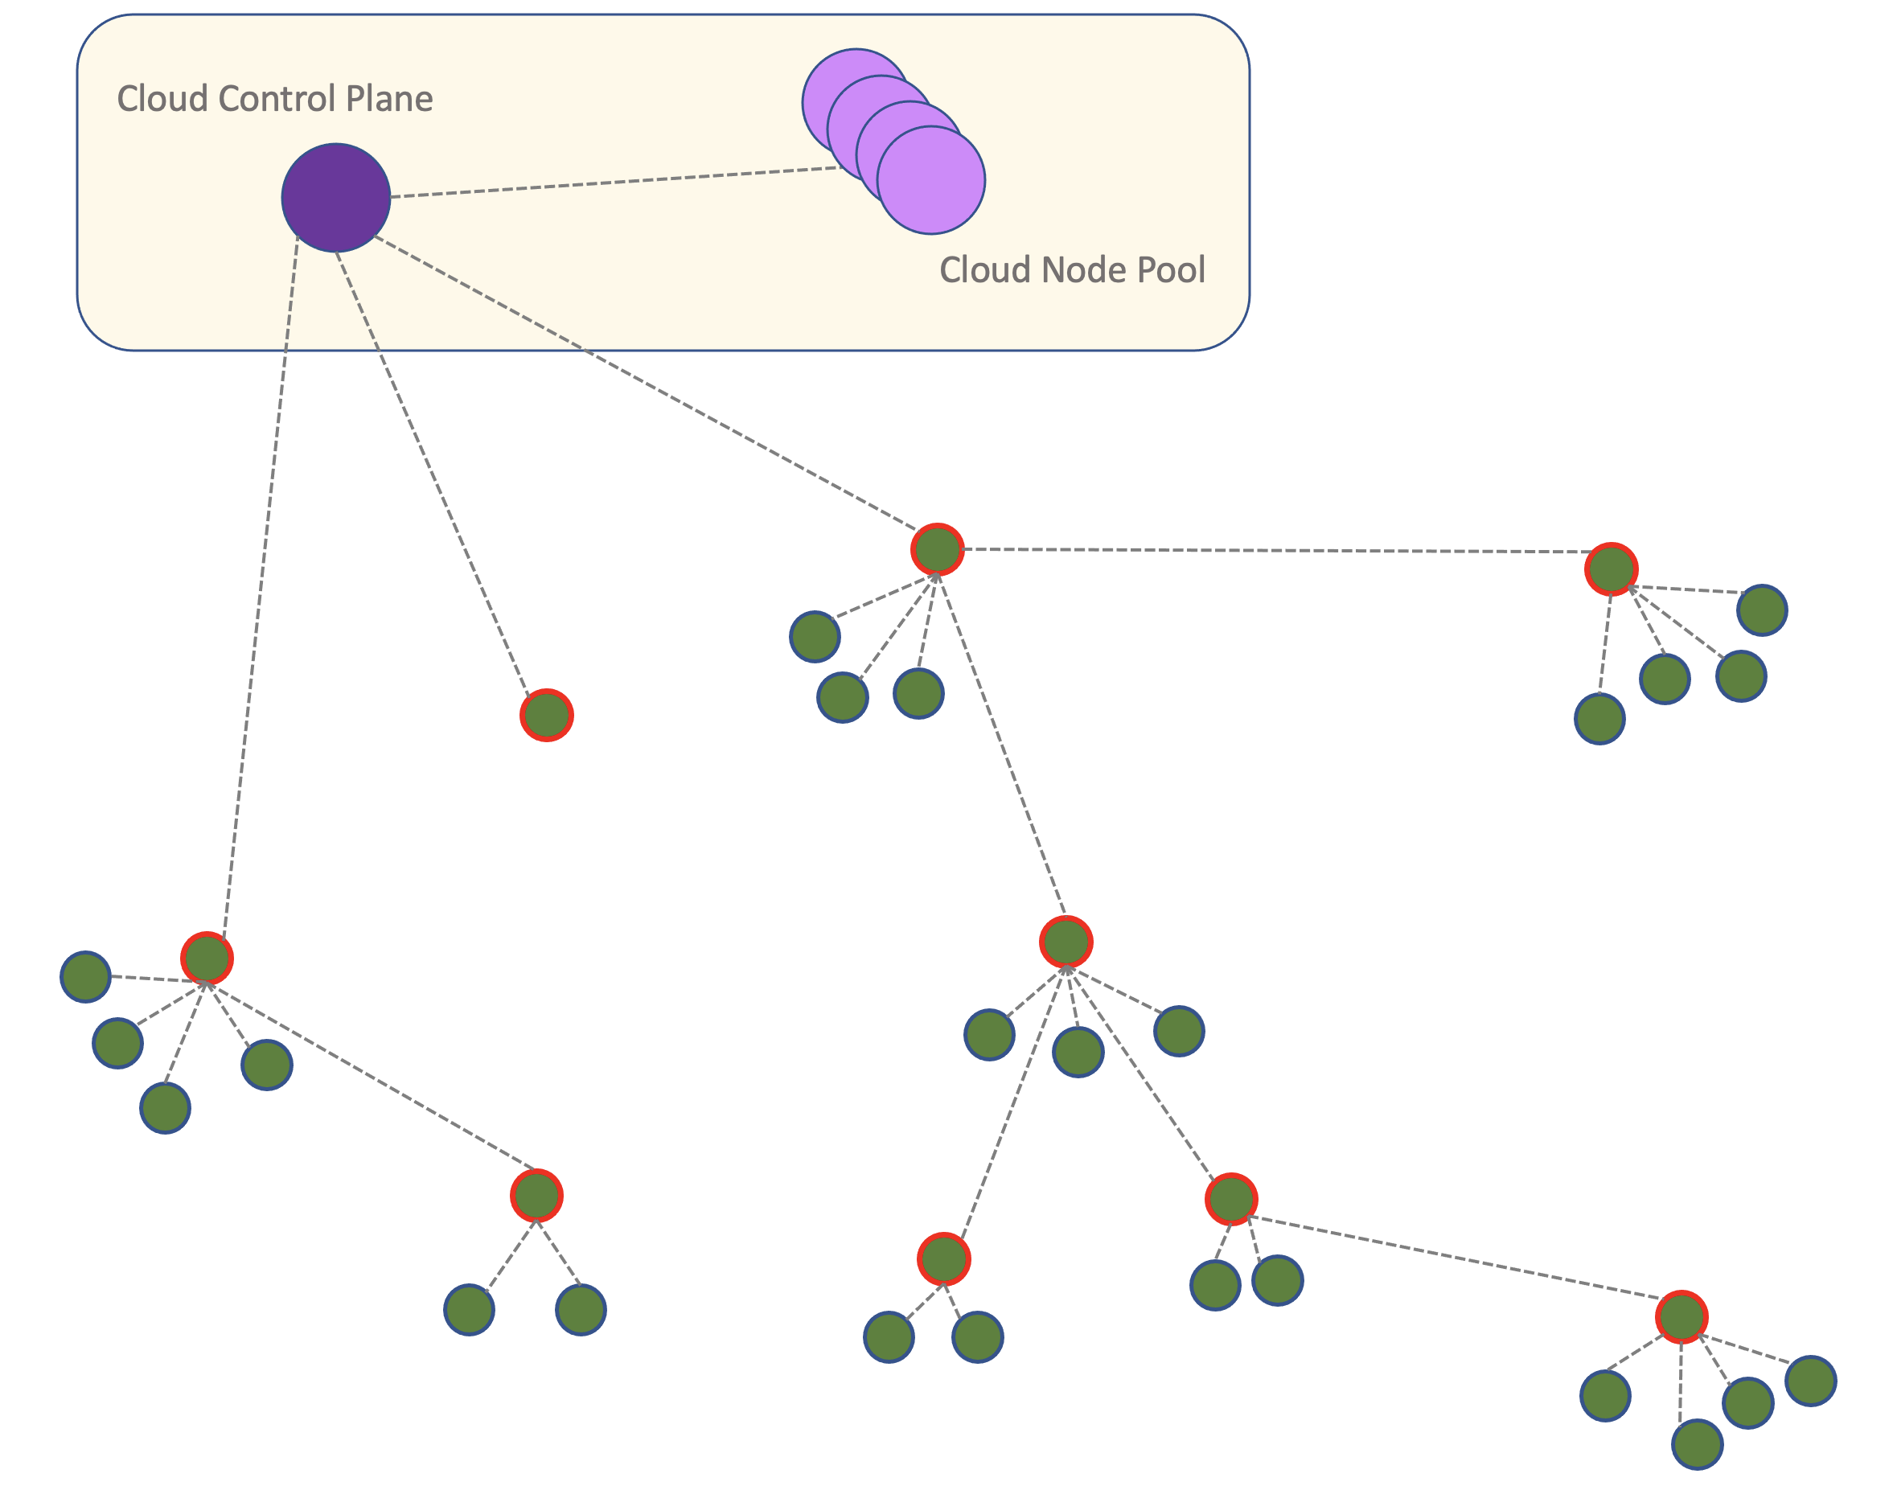
Centaurus Edge vs Global Scheduling
Global Scheduling

